Slide 1
Patrol Supplier Schedule
DBC- Planning
Now
No. | Content | PIC | Feb |  |  |  | Mar |  |  |  | Apr |  |  |  | May |  |  |  | Jun |  |  |  | Remark
 |  |  | 1w | 2w | 3w | 4w | 1w | 2w | 3w | 4w | 1w | 2w | 3w | 4w | 1w | 2w | 3w | 4w | 1w | 2w | 3w | 4w
1 | List check items point | Ms.Sikharin Agm
2 | Setting Organization team Patrol | Ms.Sikharin Agm
3 | Training member | Ms.Sikhain Agm
4 | Supplier information | Ms.Arporn Amgr
5 | Supplier patrol -1 1.SHIN HEUNG 2.MITSUWA KORAT | All
6 | Problem report -1 | Ms.Phornsiri
7 | Supplier patrol -2 1.TRIO 2.KORAT MATSUSHITA
8 | Supplier patrol -3 1.TAPACO KABINBURI
9 | Problem report -2 | Ms.Sikharin
10 | Progressive follow up | Ms.Sikharin
11 | Summary report | Ms.Sikharin
SHIN HEUNG
MITSUWA KORAT
TRIO
KORAT MATSUSHITA
TAPACO

Slide 2
Topic Evaluation
DBC- Planning
1) 5S
2) Visible
- Production Area
- QC Process
- Finished Product & Shipping Area
3) Quality Control
4) Stock Control
5) Package Control
Evaluation Result
- RAY THAI
☺
Supplier | Part (items) | Std. WIP of Box (Pcs).
RAY THAI | 185 | 8,516
Supplier | Part (items) | Std. WIP of Box (Pcs). | Actual Box support (Pcs.) | Diff
RAY THAI | 185 | 8,516 | 15,634 | 7,118

Slide 3
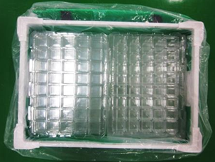
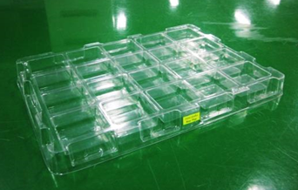
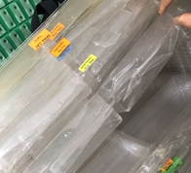

Summary Patrol Check Supplier TRIO
DBC- Planning
No | Problem | Countermeasure | Target | EVA
1. | Problem package return of tray. Partition tray are pressed against each other , damage tray broken.
2
Tray is damaged broken , causing NG
Symbol :
Finished
On plan
Problem but have countermeasure
x
Problem with no have countermeasure

Slide 4
Sensibility
DBC- Planning
Topic

